Slide 1
Reconciling faith and reason: St Augustine
Dr. Stephanie Spoto sspoto@mpc.edu
Monterey Peninsula College
Gentrain
6 February 2019

Slide 2
Faith and Reason
Justifications for religious belief → faith and reason both sources of justification →
Epistemic function of both is the same, so of interest to theologians and philosophers → how are they related? How should rational beings approach/respond to claims originating from either source?
Reconciled account: no conflict between faith and reason → reason employed properly and faith understood properly can never arrive at completing/contradictory claims
Unreconciled account: faith and reason must be in fundamental disagreement/contention over methodologies and claims

Slide 3
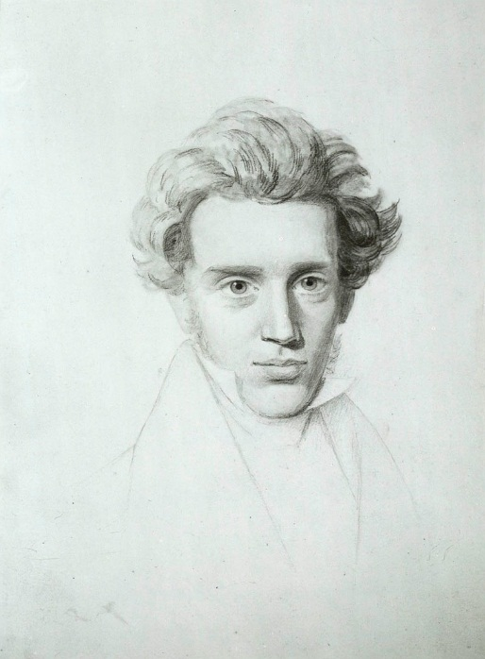
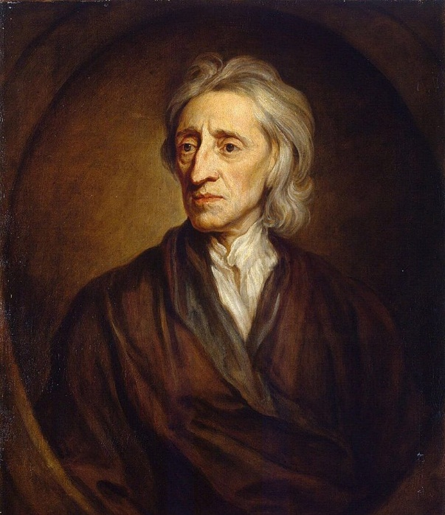
Faith versus Reason
If faith and reason come into conflict, then what?
Kierkegaard, prioritizes faith over reason to the point where his arguments become irrational.
Locke argued in favor of reason → claimed that the fact that faith functions without reason is sign that it is unsound.
Can faith and reason point to their own separate domains? Can use either to resolve different questions.

Slide 4
More recent debates in Faith and Reason
Logical positivism (logical empiricism): concepts come from experience and can be justified only through experience → scientific knowledge is the only knowledge → metaphysics cannot uncover truth
Faith vs Reason: there is no domain of existence or thought properly governed by faith → all statements with meaning or validity can be examined through rationality
Challenge to theologists/religion: How can a nonrational form of expression refer back to or hold cognitive content that is meaningful?

Slide 5
The Classical Period
Greek religion concerned with explanation of the cosmos → often expressed as literary myths.
However, this form of theology was practical: to increase virtue in the individual and in society.
Pre-Socratics: attempted to pull out the philosophical ideas from the mythological claims → then removed the “superstition” of their religious origins
Less interested in the concern of faith in these particular beliefs and religious practices.
ATOMISM
MILESIAN SCHOOL
ELEATIC SCHOOL
SOPHISTS

Slide 6
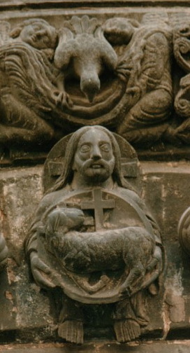
Early Christianity
Christianity → brought set system of practices and truths → differed from Judaism and Greek religions
  For example: Christians believed that God created/fashioned the world ex nihilo
  Compare this with Plato’s account of God fashioning the world from pre-existing elements: “Finding the whole visible sphere not at rest, but moving in an irregular and disorderly fashion, out of disorder he brought order” (Timeaus 29e).
  Other differences: Christians believed that God was three persons & Christ is the ultimate revelation of God.
From the beginning, Christians claimed significant unity between reason and faith.
Depiction of Trinity from Saint Denis Basilica in Paris (12th century)

Slide 7
St Augustine
Augustine → fourth century defender of Christianity
Defense against claims by pagans that Christian doctrine/beliefs were superstitious and barbaric
Compatibilism/Reconciled account: intellectual approaches to faith and religion are fides quaerens intellectum (faith seeking understanding)
credere est assensione cogitare: To believe is to think with assent.
  Faith/belief is act of intellect → intellect not controlled by reason but by will.
Faith involves commitments:
  "to believe in a God"
  "to believe God”
  "to believe in God"

Slide 8
Augustine – letter to Consentius (5th century Latin grammarian)
Heaven forbid that God should hate in us that by which he made us superior to the other animals! Heaven forbid that we should believe in such a way as not to accept or seek reasons, since we could not even believe if we did not possess rational souls. […The prophet Isaiah] said: ‘Unless you believe, you will not understand.’ Here he was doubtless distinguishing between these two things and advising us first to believe, so that afterwards we might understand what we believe. It is thus reasonable to require that faith precede reason…If, therefore, it is reasonable for fait to precede reason in certain matters of great moment that cannot yet be grasped, surely the very small portion of reason that persuades us of this must precede faith.

Slide 9
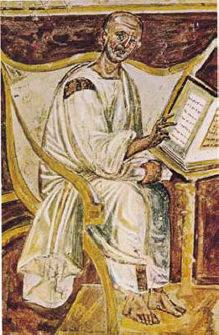
On the Christian Doctrine 426 AD
Christian teachers should make use of pagan philosophy and thought in order to interpret scripture.
Pointed out that Greek pagan science and philosophy explored the eternal and unchanging (like the Eleatic School) → can be used to understand the eternal in the Christian faith.
Unknown/ambiguous symbols in Scripture can be illuminated through pagan logic and natural sciences.
However, if it is not concerned with the eternal, then Christians ought to avoid it.
The earliest known portrait of Saint Augustine in a 6th-century fresco, Lateran, Rome

Slide 10
Augustine on Platonism
The Platonists/Neoplatonists—the best philosophers → not merely concerned on causes and methods of gaining knowledge, but on the cause of the universe itself.
Therefore, it follows, that to have a conception of God, one does not need to be a Christian → meditating on this cause was done by the pagans and therefore only required reason → suggesting that reason can lead to faith.
However, Christians are the only ones that can have this kind of knowledge without resorting to philosophy.

Slide 11
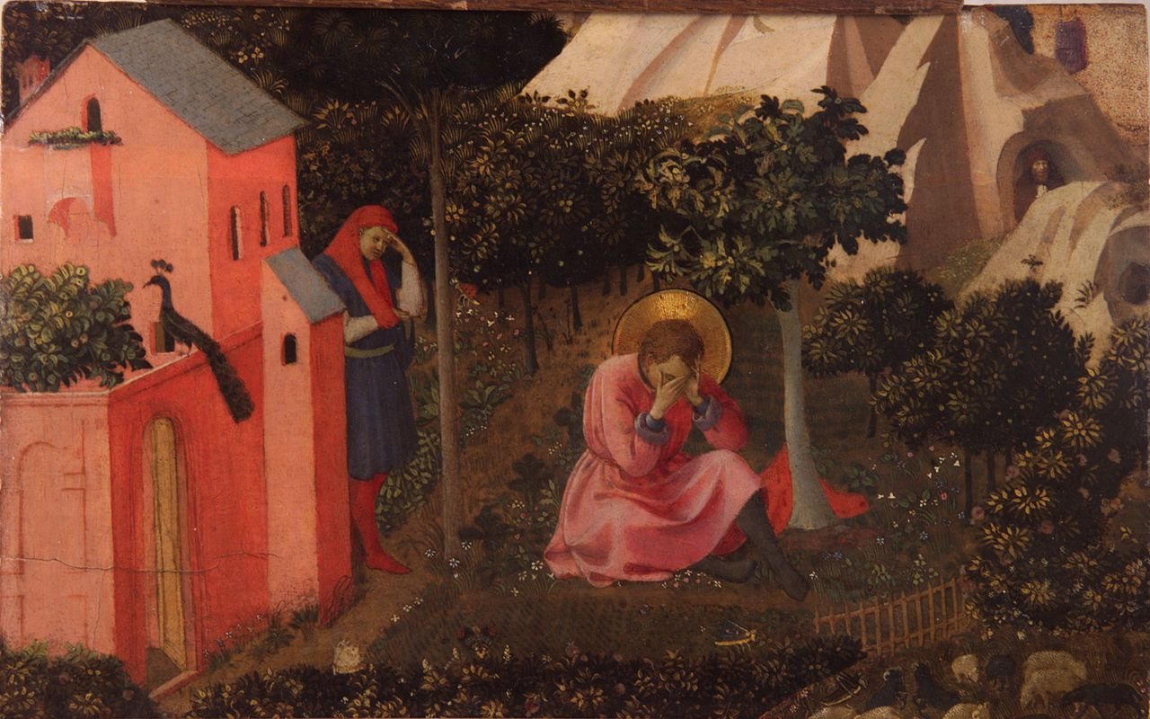
Augustine’s conversion to Christianity
The Conversion of St. Augustine by Fra Angelico, c. 1430
Converted at 31, after hearing an account of a friend reading a life of St Anthony.
Prompted by a child-like voice which told him to “take up and read” → read the first thing that he saw, which was Romans 13: “Not in rioting and drunkenness, not in chambering and wantonness, not in strife and envying, but put on the Lord Jesus Christ, and make no provision for the flesh to fulfill the lusts thereof.”

Slide 12
The Church
The use of reason in religion is not determined by the individual, but is the domain of the Church itself.
Realized that the Church is the final judge on what cannot be demonstrated or what cannot be understood by believers → prompted by long battle with Manichean heresy
  Manichaeism - a religion founded by Manes in the third century; a synthesis of Zoroastrian dualism between light and dark and Babylonian folklore and Buddhist ethics and superficial elements of Christianity; spread widely in the Roman Empire but had largely died out by 1000.
However, though he appealed to Church authority, it was love that allowed one to authentically understand God, not the Church.
“To fall in love with God is the greatest romance; to seek him the greatest adventure; to find him, the greatest human achievement.”

